Slide 1

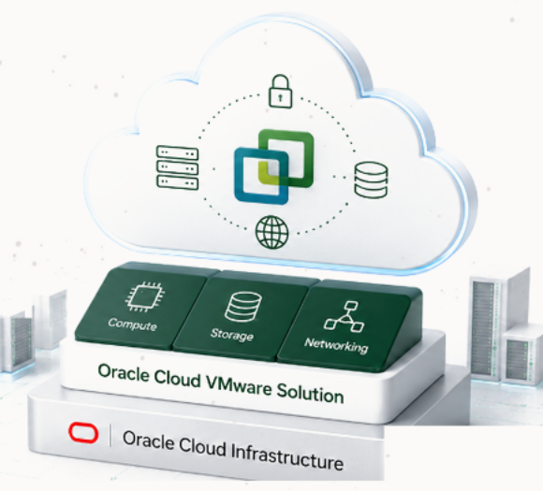




Oracle Cloud
VMware Solution
Proposed Sizing
Customer
CLIENT
Date
May 2025
Prepared By
Oracle Cloud VMware Specialist
Notes:
[Sources]
Source: slide 1 of the provided PowerPoint. Oracle logo, Oracle mark, row icons, and the right-side Oracle Cloud VMware Solution illustration are kept as cropped image assets from the source. Visible title, sizing label, and customer/date/prepared-by text are editable PowerPoint objects.

Slide 2



















Disaster recovery with Oracle Cloud VMware Solution
Create a reliable DR environment in the cloud to ensure business continuity and resilience.
Business continuity for
mission-critical applications
Maintain systems without
service disruption
Ensure recovery from
data corruption & cyberattacks
Meet defined RTO & RPO
with backups & restores
BUSINESS OUTCOMES
Minimize downtime
Quick recovery to meet
RTO & RPO targets.
ON-PREMISES PRIMARY SITE
3RD PARTY DR SOLUTIONS
ORACLE CLOUD VMWARE SOLUTION (DR SITE)
OCI Virtual Cloud Network (VCN)
Protect your data
VM
VM
VM
...
VM
Recover from corruption,
ransomware or disasters.
Your Existing
VMware Environment
VMware Environment (DR)
Compute
Storage
Network
Consistent VMware
experience
... and other 3rd party DR solutions
Same tools, processes
and skillsets.
Production workloads
Critical business applications
Bare Metal
Compute
Bare Metal
Compute
Bare Metal
Compute
Test and validate
CONNECTIVITY OPTIONS
Schedule DR drills
without impacting
production.
Users & business operations
At risk from outages, disasters
or cyber incidents
Isolated and protected DR environment
on native OCI infrastructure
Cost effective
Internet
VPN
FastConnect
Pay for capacity only
when you need it.
Schedule, test and execute your Disaster Recovery plan with confidence.
Move workloads on-demand and restore operations quickly when it matters most.
Notes:
[Sources]
Source: user-provided Disaster Recovery.pptx, slide 2. The source slide was a flattened image; titles, captions, cards, arrows, separators, DR-site labels, bullet text, business-outcome copy and the bottom callout are recreated as editable PowerPoint objects. Oracle/OCI logo, third-party product logos, and all icons are retained as cropped image assets from the provided deck.

Slide 3









Assumptions & Methodology
The proposed sizing is based on the information provided by the customer
and the following assumptions and methodology.
Sizing Methodology
Data Source
RVTools export provided by the customer
(Analysis Date: May 08, 2025)
Sizing Approach
Capacity based on current utilization
and projected growth
CPU Contention Ratio
1:6
(Industry standard for medium consolidation)
Average Utilization
vCPU: 50%
vMEM: 60%
Target Utilization
80%
(For both vCPU and vMEM)
Storage Type
OCI Block Volume
(Block Storage)
Copyright © 2026, Oracle and/or its affiliates | Confidential: Internal/Restricted/Highly Restricted

Slide 4













Current Environment
Analysis based on RVTools data shared by the customer.
Datacenter 1 – CLIENT
VMs
vCPUs
vRAM (GB)
Storage (TB)
20,100
3,000
30,000
210
18,400
Powered On
1,700
Powered Off
Total VMs
Total vCPUs
Total vRAM (GB)
Total Storage (TB)
20,100
3,000
30,000
210
Total Environment
18,400 Powered On
1,700 Powered Off
This sizing is based on the information available at the time of analysis and should be validated during the detailed design phase.
Copyright © 2026, Oracle and/or its affiliates | Confidential: Internal/Restricted/Highly Restricted
Notes:
[Sources]
Source image: user-provided screenshot "Current Environment". Oracle logo, Oracle mark, datacenter icon, metric icons, total-environment icon, and information icon are embedded as cropped image assets from that screenshot. The visible title, subtitle, panel headers, labels, metric values, notes, footer, cards, separators, and decorative background elements are recreated as editable PowerPoint objects.

Slide 5





Infrastructure Sizing Summary
The following architecture on Oracle Cloud VMware Solution (OCVS) has been designed
to support the customer's current environment with room for future growth.
Proposed Architecture
Cluster Distribution
SDDCs
1
Clusters
1
Production
Hosts
4
Shape
AMD E4
4
x AMD E4
Storage
200 TB
200
TB
Storage Type
OCI Block Volume
Right-sized architecture designed to support current workloads and future growth
while optimizing cost and performance.
Copyright © 2026, Oracle and/or its affiliates | Confidential: Internal/Restricted/Highly Restricted
Notes:
[Sources]
Source: slide 3 of the provided PowerPoint. Oracle logo, Oracle mark, and all metric/panel icons are kept as cropped image assets from the source. Title, explanatory text, architecture table, cluster card, values, callout, footer, panels, and separators are recreated as editable PowerPoint objects.

Slide 6

Confidential - Oracle Restricted \Employees
Only
Confidential - Oracle Restricted \Employees
Only
Notes:
[Sources]
Source: slide 4 of the provided PowerPoint. Oracle logo is kept as a cropped image asset from the source; confidentiality labels and grey background are editable PowerPoint objects.

